Slide 1
THE
AMAZON
ANALYTICS
2025 November 25
Harsh Bagrao
Tool Used : Power BI, MySQL

Slide 2

OBJECTIVE
Amazon hosts thousands of products across multiple brands and categories.
Understanding which brands perform well, which categories dominate, and how pricing affects popularity is critical for:
  Improving product strategies
  Identifying high-performing segments
  Understanding consumer behavior patterns
  Supporting data-driven business decisions
However, the raw data contains inconsistencies such as missing values, duplicate brands, inconsistent categories, and unstructured product information.
2

Slide 3

DATASET DESCRIPTION
Dataset Overview
  Source: Amazon Product Dataset
  Total Records: ~14,000+ products
  Tables Used:
    dim_brand
    dim_category
    dim_availability
    dim_product
    fact_product_metrics
3

Slide 4
DATA CLEANING & TRANSFORMATION?
1. Data Import & Initial Checks
2. Data Cleaning Steps
3. Merging & Lookup Mapping
  Connected Power BI to MySQL database
  Imported all 5 tables: Brand, Category, Availability, Product, Fact Metrics
  Checked row counts & schema validation
  Ensured PK–FK relationships matched the snowflake schema
  Removed duplicate brand & category names
  Trimmed and standardized text fields (Brand Name, Category Name, Product Name)
  Applied Proper Case to ensure consistent formatting
  Cleaned product names (removed symbols, brackets, extra spaces)
  Fixed mismatched brand names by merging with cleaned brand dimension
  Corrected wrong category assignments
Created clean product and fact tables by merging:
  Product → Brand (to get Brand_ID)
  Product → Category (to get Category_ID)
  Fact Table → Brand, Category, Availability
  Ensured all foreign keys accurately map to dimension tables.
4. Feature Engineering
5. DAX Measures Created
6. Final Data Model (Snowflake Schema)
  Created Price Category
  Low / Medium / High / Premium
  Converted Scrape Date → Day for better trend analysis
  Generated Popularity-Based Revenue metric
  Added calculated columns for analytics
  Total Revenue
  Average Rating
  Total Reviews
  Total Products
  Average Popularity
  High Price Products
  Category-Wise & Brand-Wise KPIs
  Time-based trend measures
  Fact table linked to Brand, Category, Availability, Product
  Clean, optimized model for visual performance
  Enabled slicers for brand, category & price segments
5

Slide 5

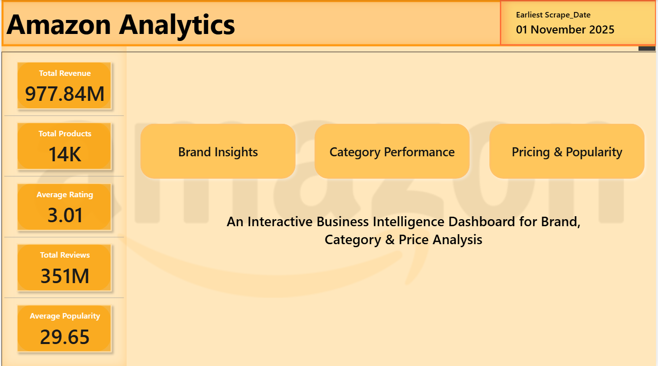
HOME PAGE OVERVIEW
Purpose of the Home Page
The Home Page acts as the central navigation hub for the entire dashboard.
It provides a clean, intuitive entry point for exploring Brand, Category, and Pricing insights.
Key Elements
1. Dashboard Title & Theme
  Amazon-inspired design with dark layout
  Clean typography and professional layout
  Consistent branding across all pages
2. Navigation Buttons
  Brand Insights
  Category Performance
  Pricing & Popularity
  Interactive page buttons improve user experience
  Buttons styled using Amazon colors (Black, Orange, White)
3. KPI Summary Row
Provides a quick overview of the entire dataset:
  Total Revenue
  Total Products
  Average Rating
  Total Reviews
  Average Popularity Score
6

Slide 6
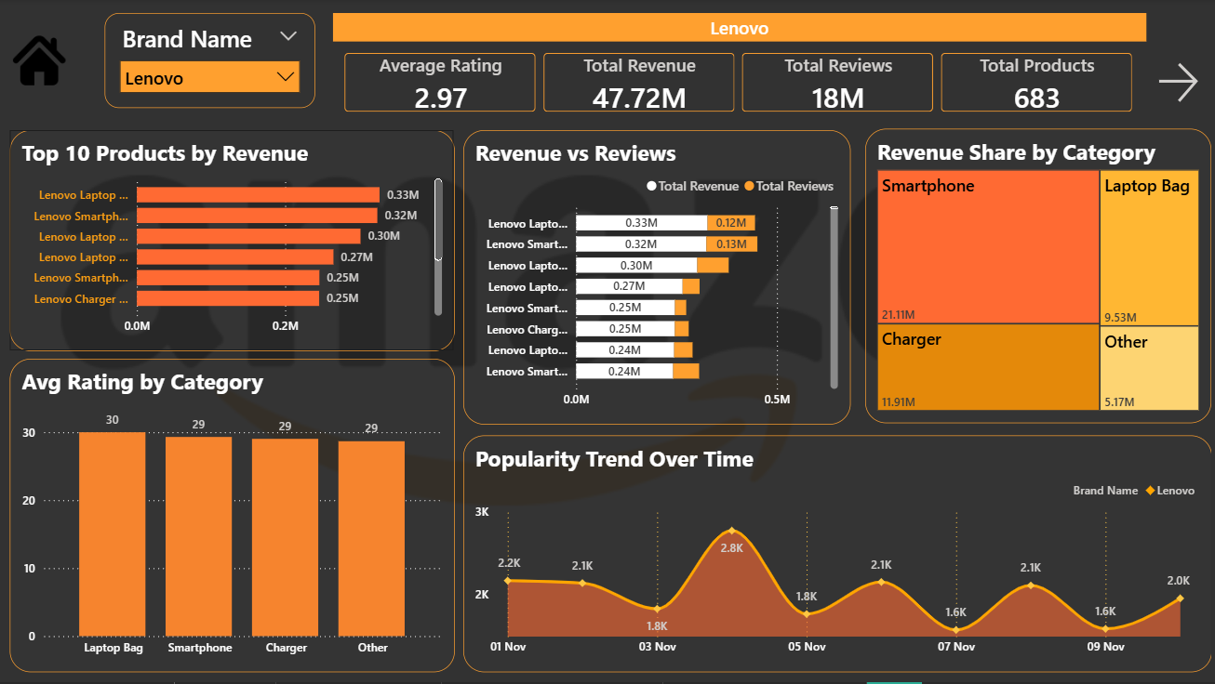
BRAND INSIGHTS
To analyze and compare the performance of each brand across multiple metrics such as revenue, reviews, ratings, category share, and popularity trends.
This page provides brand-level analytics that help answer:
  Which brands drive the most revenue?
  How do customer reviews differ by brand?
  Which categories are most important for each brand?
  How does popularity change over time?
Insights This Page Helps Identify
  High-value brands
  Best-selling product lines
  Brand category specialization
  Review-driven sales patterns
  Seasonal or trend-based popularity changes
7

Slide 7
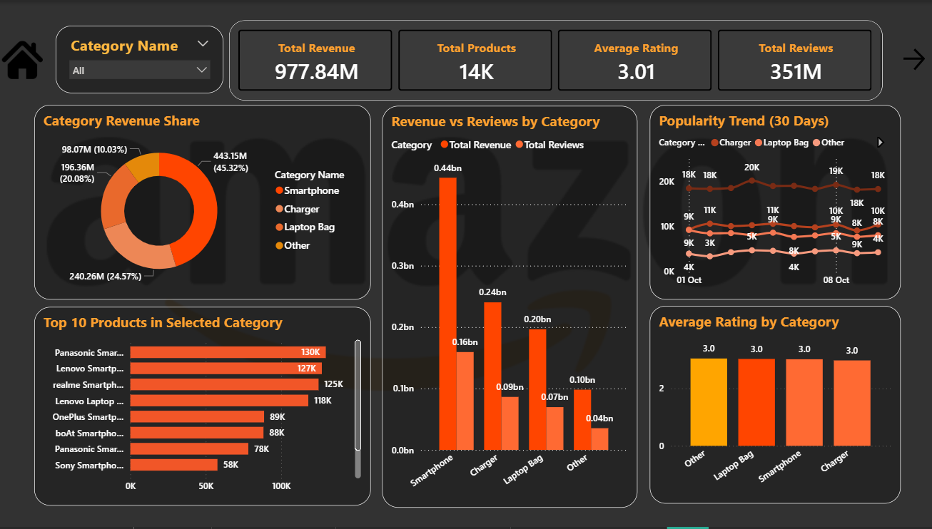
CATEGORY PERFORMANCE
Purpose of the Category Performance Page
This page provides a category-level deep dive into Amazon product performance.
It helps identify:
  Which categories contribute the most revenue
  Which categories have the best customer ratings
  Which product categories are growing in popularity
  Top-performing products within each category
This page is essential for understanding market segmentation and product strategy.
Insights This Page Helps Identify
  High-revenue categories
  Underperforming categories needing improvement
  Categories with strong customer ratings
  Price-sensitive or review-driven categories
  Inventory planning and marketing focus areas
8

Slide 8

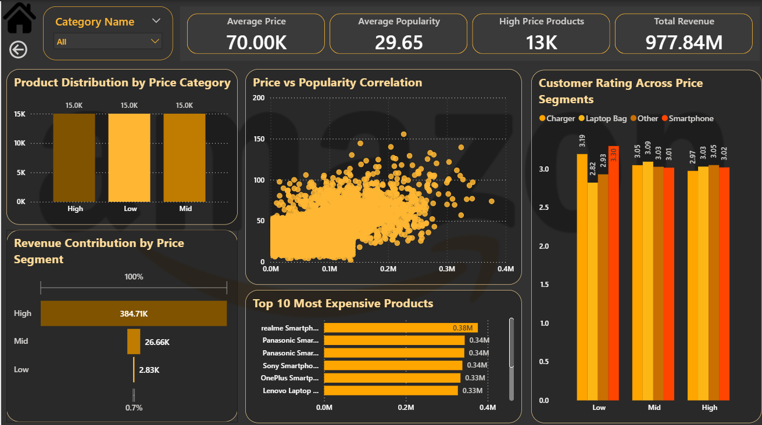
PRICING & POPULARITY INSIGHTS
Purpose
To understand how product pricing influences customer engagement, ratings, and overall demand. This dashboard highlights the relationships between price tiers, popularity trends, and revenue contribution to help identify optimal pricing strategies.
Key Insights
  Higher and lower price segments show distinct popularity patterns.
  Revenue contribution varies across price tiers, revealing profitable pricing zones.
  Relationship between price and ratings helps evaluate customer value perception.
  Top high-value products indicate where premium pricing is justified.
  Price–popularity patterns support smarter pricing and product positioning decisions.
9

Slide 9
THE END
THANK YOU FOR LISTENING
2025 November 25
Harsh Bagrao
Tool Used : Power BI, MySQL

